Slide 1
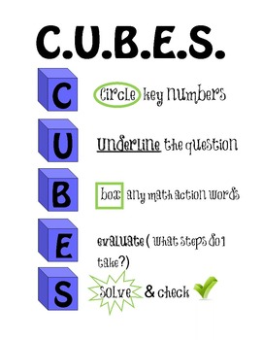
Third Grade
PROBLEM SOLVING STRATEGIES
3rd Grade Curriculum
The expectations for third grade have been set! Students are settled and ready to continue their learning. As we work through Quarter 2, please remind your child of the importance of using classroom taught strategies, including CUBES and RUNNERs when working on problem solving. Students need to master the skill of analyzing problem solving to continue to be successful.
For
solving math problems
Quarter 2
Abbotts Creek Elementary
aces3rdgrade.weebly.com
For reading passages
What Will We Learn?
Math
Reading
Writing
Multiplication and Division Represent, interpret, and solve one-step problems involving multiplication and division
Problem Solving Solve two-step word problems using addition, subtraction, and multiplication, representing problems using equations with a symbol for the unknown. Geometry – recognize, compose,
investigate and categorize two
dimensional shapes and
attributes
Pourquoi Tales – write original narrative text establishing characters, problem, solution and using revisions
Informational Texts – write multi-paragraph informational texts, including research and facts from cited sources
Fiction – comprehend and analyze poetry and pourquoi tales
Nonfiction – ask and answer questions referring explicitly to the text to research a topic
Vocabulary – determine the meaning of unknown words while reading
Both fiction and nonfiction!
Be on the lookout for information about our Multiplication Ice Cream Parties! The more students memorize, the bigger the sundae!
Resources:
TheWCPSSAcademics youtube channel – teachers demonstrating math strategies
aces3rdgrade.weebly.com – check weekly for updates and specific curriculum focuses
From ACES website: Click on “Parents” then “Homework Resources” for EL information
Continue to follow your child’s homeroom on ClassDojo
Ways to Help
Important Dates
Nov. 20 – Early Release: 1:15 dismissal
Nov. 21-23 – No school
Dec. 4 – Interims
Dec. 21 – Early Release: 1:15 dismissal
Dec. 24-Jan 2 – Winter Break – no school
Continue helping your child MEMORIZE MULTIPLICATION fact!
Encourage your child to write about his or her reading. Writing a paragraph response will nightly reading will build writing and comprehension skills.

